Slide 1
SAFESPEAK
Toxic and Nontoxic Comments Detection
KHADEEJA BEEVI C N
MCA S3
ROLL NO:27

Slide 2
INTRODUCTION
SafeSpeak project is to develop an automated system capable of classifying comments as either toxic or non-toxic.
Online platforms often face challenges with toxic or abusive comments which can negatively impact user experience and safety.
By automating the detection of such comments, SafeSpeak aims to provide a tool that supports better content moderation and fosters a more positive online community.

Slide 3
TECHNOLOGY STACK
Libraries & Frameworks
Transformers: An open-source library from Hugging Face that provides state-of-the-art pre-trained models for various NLP tasks, including BERT.
Datasets: A library for accessing and working with datasets. Used here to load and preprocess the toxic comments dataset.
scikit-learn: A machine learning library for Python, used for metrics and evaluation.
PyTorch: An open-source machine learning library used for training the BERT model.
Matplotlib: A plotting library for creating visualizations like confusion matrices.

Slide 4
TECHNOLOGY STACK
Model: bert-base-uncased
BERT (Bidirectional Encoder Representations from Transformers): A transformer-based model pre-trained on a large corpus of text.
BERT's bidirectional approach helps it understand context better, making it suitable for classification tasks such as detecting toxic comments.
It is a powerful NLP model developed by Google that utilizes a Transformer architecture to understand text in both directions simultaneously.
It is pre-trained using two main tasks: Masked Language Modeling (MLM), where it predicts masked words in a sentence, and Next Sentence Prediction (NSP), which helps it understand sentence relationships.

Slide 5
TECHNOLOGY STACK
Dataset
AiresPucrs/toxic-comments from the Hugging Face Datasets library.
it is around 7000 rows of data.
Contains comments labeled as toxic or non-toxic, providing a basis for training and evaluating the model.
The binary label indicating the toxicity of the comment (1 for non-toxic, 0 for toxic).
Training Set: Used to train the model. Typically comprises around 80% of the total data.
Testing Set: Used to evaluate the model during training. Typically comprises around 20% of the total data.

Slide 6
MODEL TRAINING
Data Preparation
Tokenization
Custom dataset creation
Model initialization
Training configuration
Training process
Validation and Evaluation
Hyperparameter Tuning
Model saving
Inference and Deployment

Slide 7
EXAMPLE
Example Comment: "Hello, world! How are you?"
Tokenized Output: ['hello', ',', 'world', '!', 'how', 'are', 'you', '?']
Token IDs Example:[7592, 1010, 2088, 999, 2129, 2024, 2017, 1029]
Special Tokens : ['[CLS]', 'hello', ',', 'world', '!', 'how', 'are', 'you', '?', '[SEP]']
Token IDs with Special Tokens:[101, 7592, 1010, 2088, 999, 2129, 2024, 2017, 1029, 102]

Slide 8
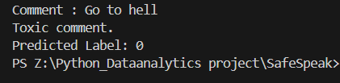
OUTPUT

Slide 9
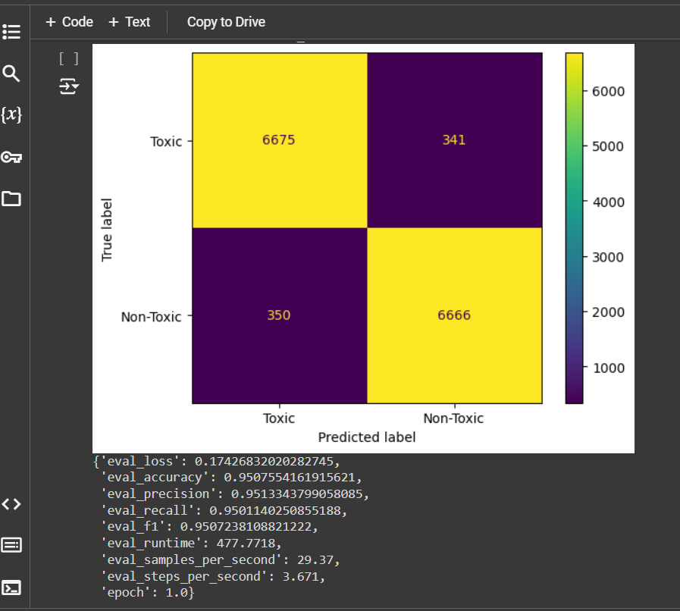
PERFORMANCE METRICS

Slide 10
APPLICATIONS
Integration into Social media and Chat Platforms
Sentiment Analysis
Fake News Detection
Market research
Chatbots and Virtual Assistants

Slide 11
CONCLUSION
Advancing NLP with BERT The implementation of models like BERT revolutionizes natural language processing, enabling more accurate understanding and classification of human language.
Broad Applications Across Industries From social media analysis and customer feedback to mental health monitoring, BERT-powered systems have broad, versatile applications
Future Innovations and Opportunities As we continue to improve NLP models like BERT, the potential for creating safer, more engaging, and responsive digital environments grows.

Slide 12
THANK YOU

